Slide 1
Democratization of Taiwan
Saimanas Reddy

Slide 2
Why is discussing this important?
Model of Peaceful Transition
Influence of Cultural and Social Factors
Implications for Cross-Strait Relations
Advancements in Human Rights and Legal Reform
Global Significance in Democratic Theory

Slide 3
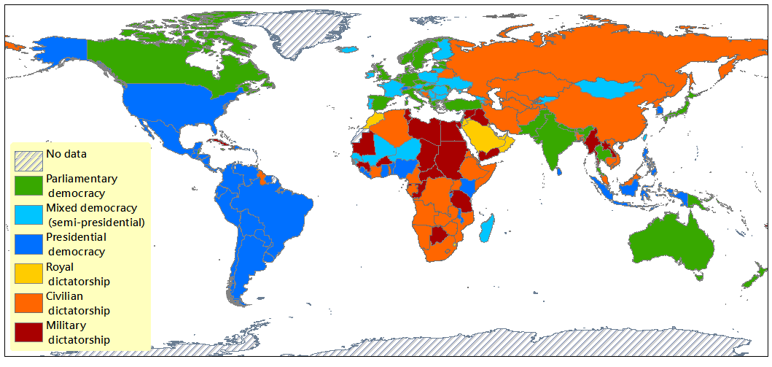
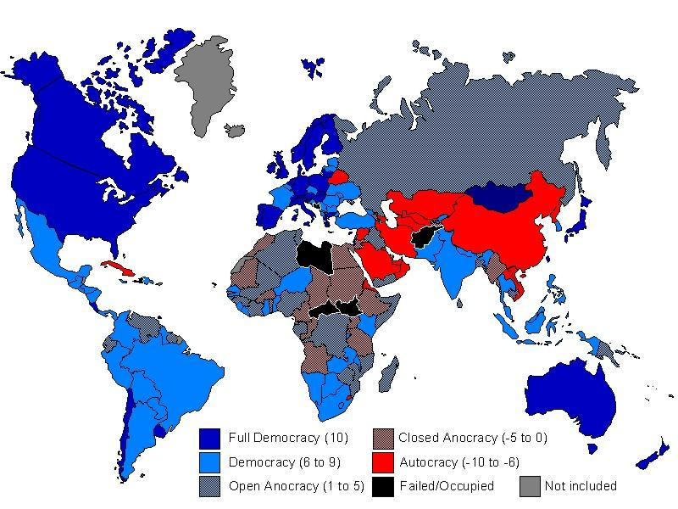
What type of regime is Taiwan today?
Mixed Democracy (Semi-presidential)
Polity Map 2013
Full Democracy
Democracy-Dictatorship Index Map 2008

Slide 4
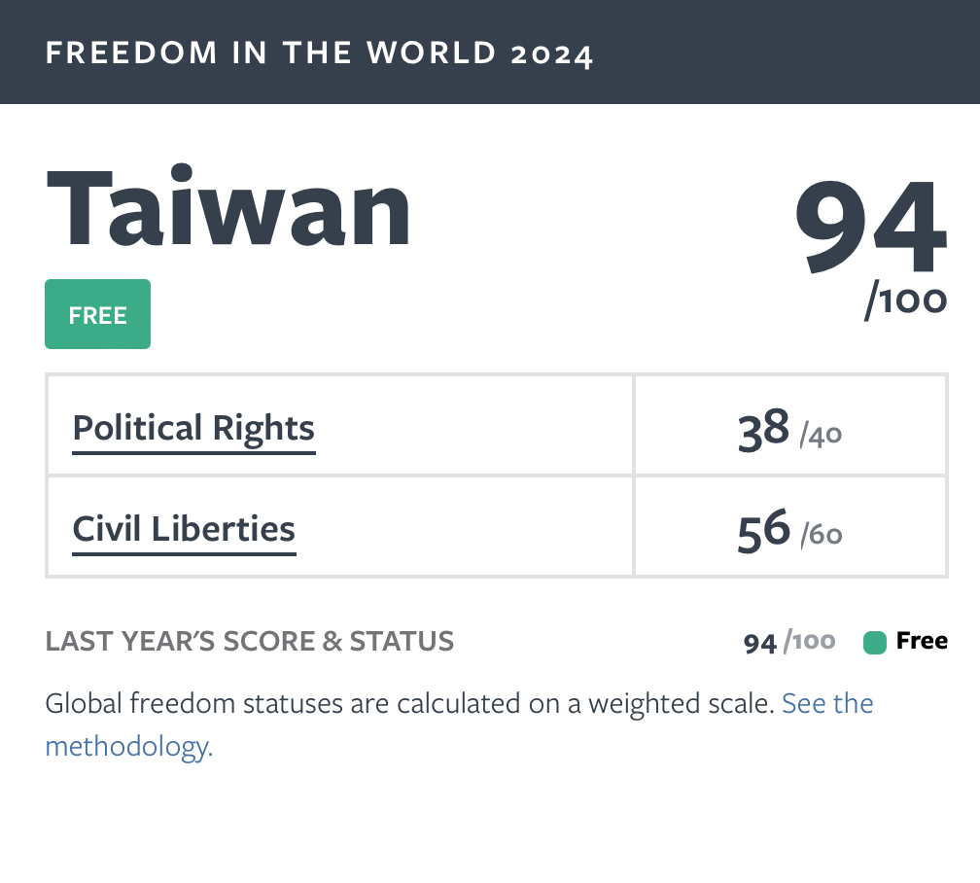
What type of regime is Taiwan? (Cont.)
Freedom House 2024

Slide 5
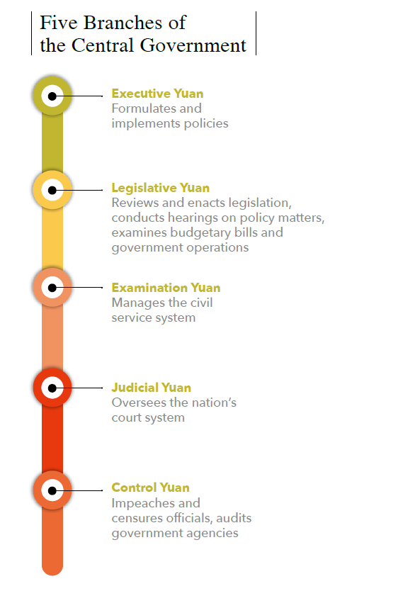
Political Order of Taiwan
Presidential System:
  Semi-presidential democratic republic.
  President serves as head of state with significant executive powers.
Executive Branch:
  Led by the Premier, who heads the Executive Yuan.
  Premier appoints Cabinet members to run various ministries.
Legislative Branch:
  Unicameral Legislative Yuan.
  Legislators elected through a mix of single-member districts and proportional representation.
Judicial Branch:
  Judicial Yuan oversees the judiciary and constitutional interpretations.
Local Governance:
  Divided into municipalities, counties, and cities.
  Local elected councils and mayors/magistrates.

Slide 6
Political Divisions of Taiwan
Major Political Parties:
  Democratic Progressive Party (DPP)
  Kuomintang (KMT)
Minor Parties:
  Includes Taiwan People’s Party (TPP), New Power Party (NPP), among others focusing on specific issues like governance reform and social justice.
Cross-Strait Relations:
  Difficult relations with People’s Republic of China (PRC).
  Political stance of ruling party significantly impacts the nature of cross-strait relations.

Slide 7
Historical Background for Taiwan
1895
  Taiwan ceded to Japan after the First Sino-Japanese War.
1945
  Taiwan returns to Chinese control after Japanese defeat in WWII.
1947
  February 28 Incident: Anti-government uprising and subsequent harsh crackdown by the KMT (Kuomintang).
1949
  KMT retreats to Taiwan after losing the Chinese Civil War.
  Establishment of martial law which lasts for decades.
1970s-1980s
  Gradual easing of martial law.
  Economic boom, leading to increased international trade and investment.
  Rise of local Taiwanese identity and political consciousness.
1986
  Formation of the Democratic Progressive Party (DPP), challenging KMT's monopoly on power.
1987
  Lifting of martial law after 38 years.
  Start of significant political reforms.
1990s
  Major democratic reforms: Direct presidential elections, full legislative turnover.
  Lee Teng-hui, a Taiwan-born leader, fosters additional democratic reforms and Taiwanization of politics.
2000
  First non-KMT president elected (Chen Shui-bian of the DPP), marking a significant milestone in Taiwan's democratization.

Slide 8
First Article: “From Authoritarian Policing to Democratic Policing: A Case Study of Taiwan" Thesis
Article by Dr. Cao L., Dr. Huang L., & Dr. Sun I. (2016)
The article explores Taiwan's transition from authoritarian to democratic policing, highlighting the political and cultural shifts that facilitated this change. It emphasizes the need for police to embody democratic values in their practices for democracy to endure.

Slide 9
First Article: “From Authoritarian Policing to Democratic Policing: A Case Study of Taiwan" Evidence
Historical Overview: The article provides a historical context of Taiwan, detailing the period of martial law and its impact on policing. It notes significant political concessions and reforms initiated by leaders like Chiang Ching-Kuo and Li Denghui, which were crucial for peaceful democratization.
Contrast between Policing Styles: It describes the key differences between authoritarian and democratic policing, focusing on aspects such as political neutrality, accountability, and service orientation. The article uses empirical data from Taiwan's police reforms to illustrate these differences.
Cultural and Institutional Challenges: Discusses the challenges in reforming policing practices due to Taiwan's post-Confucian culture and the entrenched authoritarian legacy within the police force.

Slide 10
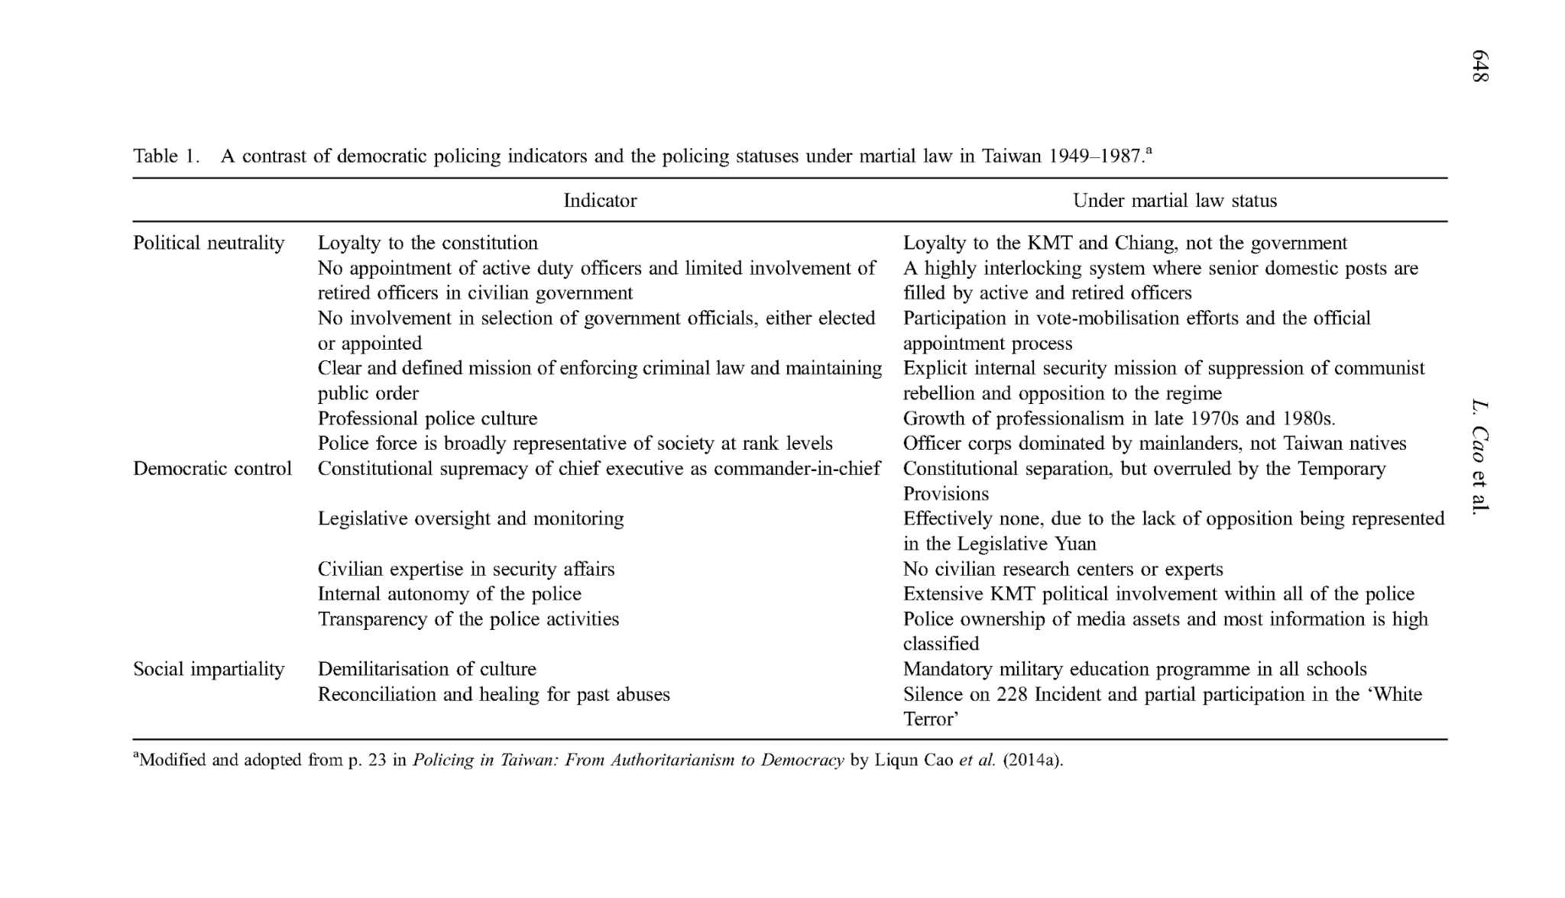
First Article: “From Authoritarian Policing to Democratic Policing: A Case Study of Taiwan" Evidence Cont.

Slide 11
First Article: “From Authoritarian Policing to Democratic Policing: A Case Study of Taiwan" Conclusion
Sustained Reforms Are Crucial: The article concludes that for democratic values to be deeply integrated into policing, continuous reforms are necessary. It argues that these reforms must address both the structural and cultural legacies of the authoritarian past.
Impact on Broader Democratization: It asserts that the transformation in policing is indicative of broader democratic advancements in Taiwan. The article suggests that changes in policing not only reflect but also contribute to the overall process of democratization.
Implications for Other Societies: Finally, the findings are positioned to inform other post-Confucian or transitioning societies on the complexities of democratizing policing within different cultural and historical contexts.

Slide 12
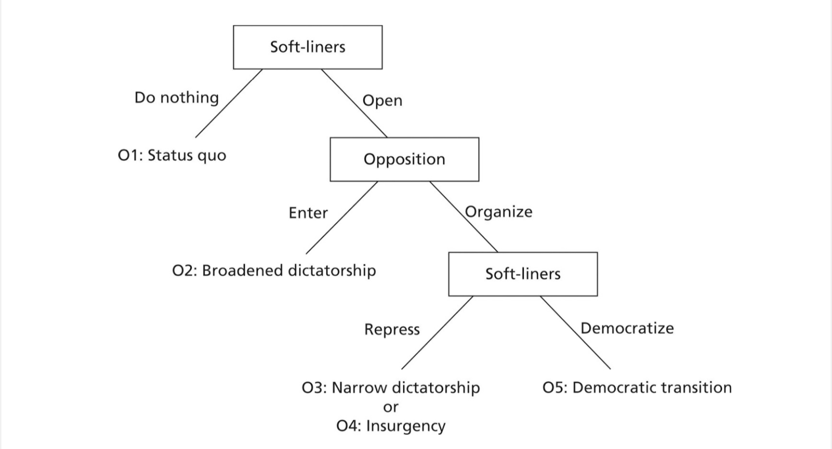
How does the First Article Apply: Modeling Democracy
Soft-liners within the KMT, represented by figures like Lee Teng-hui, chose to open up political space rather than maintaining the status quo. This involved initiating reforms that ultimately led to a movement towards democratization, resulting in a schism within the KMT and paving the way for the success of the previously weak opposition.
The opposition, embodied by the Democratic Progressive Party (DPP) and other political actors, chose to organize and actively participate in the political process rather than remaining passive. This organization served as a unifying platform but initially lacked the strength to challenge the ruling KMT effectively.
These actions led to an expanded political space, which gradually shifted towards democratization, moving away from repression or insurgency. The emergence of the DPP significantly shifted the trajectory of Taiwan’s political transformation beyond the control of the one-party system.
The ultimate outcome of these developments was a transition to a democratic system in Taiwan. The article details how this transition led to the establishment of a genuine democracy, prompting demands for greater accountability from the KMT regime.

Slide 13
Second Article: “Culture, Citizenship Norms, and Political Participation: Empirical Evidence from Taiwan” Thesis
This article is by Dr. Chang W.C. (2016)
The study investigates how religion and cultural values shape citizenship norms in Taiwan, an East Asian context fundamentally different from Western democracies.
It examines the effects of these norms on both conventional (e.g., voting) and unconventional (e.g., protesting) political participation.

Slide 14
Second Article: “Culture, Citizenship Norms, and Political Participation: Empirical Evidence from Taiwan” Evidence
Data from the Taiwan Social Change Survey (TSCS) 2004 is analyzed to explore the impact of Eastern religions (Buddhism, Taoism, and Folk Religions) on citizenship norms.
The study identifies two types of citizenship norms:
  Duty-based citizenship: Emphasizes traditional roles like obeying laws and voting.
  Engaged citizenship: Focuses on active engagement such as protests and petitions.
Finds that age and education are significant predictors of engaged citizenship norms, suggesting generational shifts in civic attitudes.
Religious beliefs significantly influence duty-based citizenship, with varied effects on engaged citizenship depending on the religion.

Slide 15
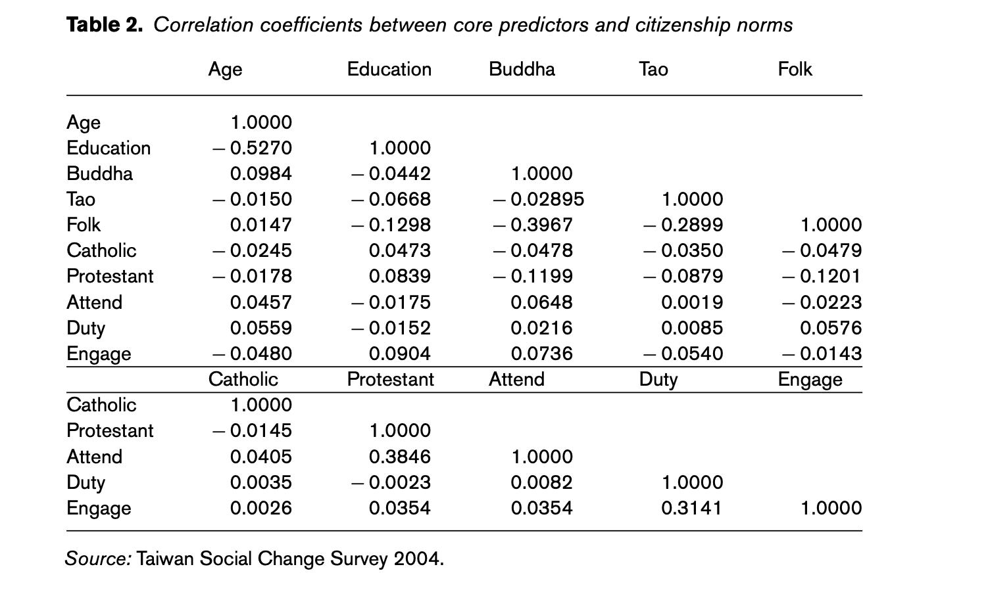
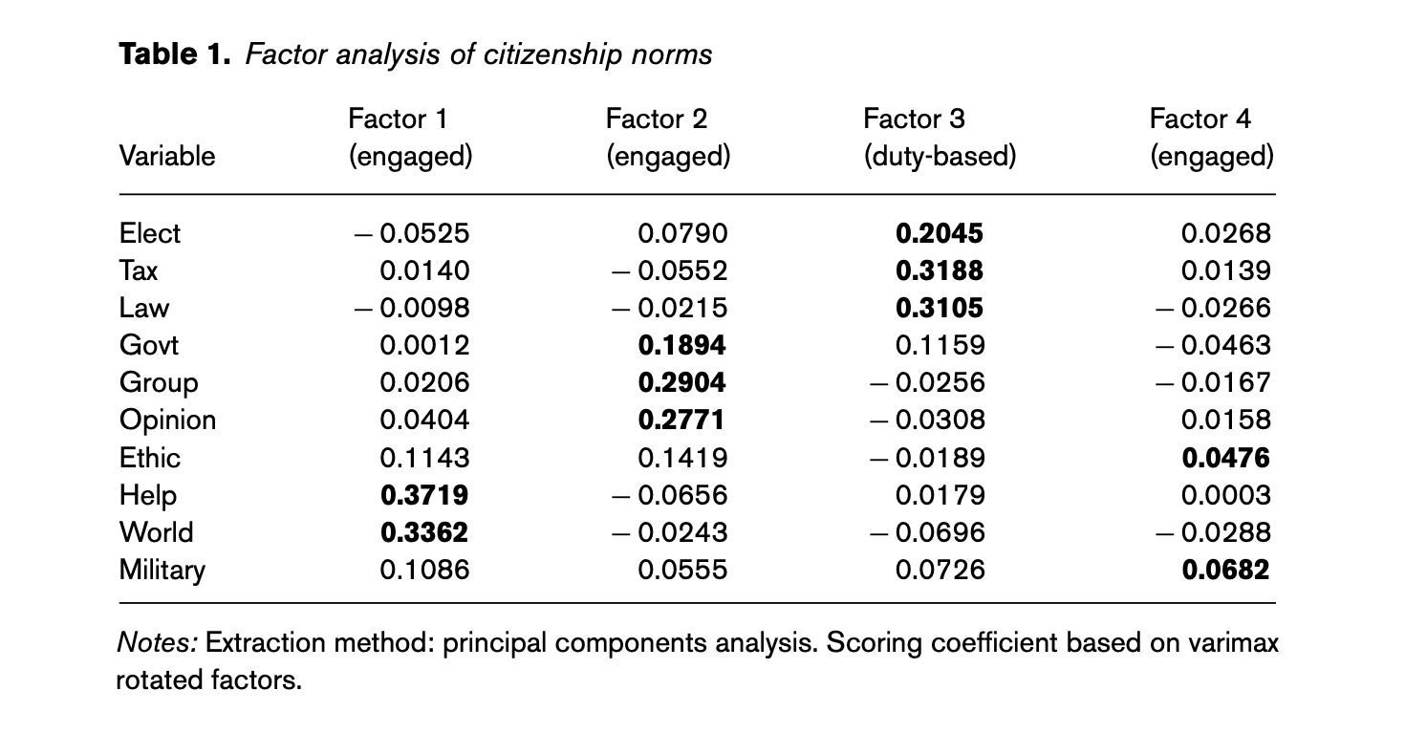
Second Article: “Culture, Citizenship Norms, and Political Participation: Empirical Evidence from Taiwan” Evidence Cont.

Slide 16
Second Article: “Culture, Citizenship Norms, and Political Participation: Empirical Evidence from Taiwan” Conclusion
Duty-based citizenship is strongly correlated with conventional political participation, such as voting and political donations.
Engaged citizenship is more aligned with unconventional participation, such as protests and boycotting.
The study highlights the significant role of media, particularly the internet, in shaping citizenship norms and political participation.
Concludes that both duty-based and engaged citizenship norms have unique and significant impacts on the types of political participation among citizens in Taiwan.

Slide 17
How does the Second Article Apply: Classical Culture Arguments
In the textbook, 2 Researchers: Mill and Montesquieu share their views on what norms develop a society-
Mill's Argument: Suggests that the success of democratic governance is dependent on the cultural characteristics of the society. Mill argued that some cultures might be more conducive to democracy than others due to their historical and social conditions, but also noted that cultures can evolve and adapt over time.
Montesquieu's Perspective: Emphasized the role of cultural practices, particularly the laws and spirits of a nation, in shaping the nature of its political institutions. He associated certain types of climates and religions with more despotic or more democratic governance systems.

Slide 18
How does the Second Article Apply: Classical Culture Arguments Cont.
Application to the Taiwan Article
Cultural Influence on Democratic Norms:
  The article identifies how traditional Eastern religions (Buddhism, Taoism, Folk Religions) influence the development of citizenship norms in Taiwan, which aligns with Mill’s notion that cultural attributes significantly impact political behavior. The study finds that these religions foster a duty-based view of citizenship, emphasizing traditional, communitarian values that Montesquieu might associate with stable governance.
  Textual Evidence: "Buddhism, Taoism, and Folk Religions in Taiwan influence norms of citizenship and political participation, supporting the textbook's view of culture's profound impact on political life"​​. (Pg. 256)

Slide 19
How does the Second Article Apply: Classical Culture Arguments Cont.
Application to the Taiwan Article
Evolution of Cultural Norms:
  Reflecting Mill's view on the adaptability of cultures, the article illustrates a shift towards more engaged forms of citizenship, driven by socio-economic transformations and increased educational attainment. This evolution supports more liberal, individualistic forms of engagement, such as protests and petitions, indicative of a cultural shift towards values that support democratic governance.
  Textual Evidence: "engaged citizenship norms are usually supportive of elite-challenging political activities, such as protesting, signing petitions, or boycotting products for political or ethical reasons"​​. (Pg. 258)

Slide 20
How does the Second Article Apply: Classical Culture Arguments Cont.
Application to the Taiwan Article
Economic and Social Transformation:
  Montesquieu’s argument that the spirit of the laws reflects the spirit of the people is echoed in the article’s findings that economic liberalization and globalization have reshaped cultural and citizenship norms in Taiwan. This transformation is in line with Mill's assertion that economic and social developments can lead to cultural adaptations conducive to democracy.
  Textual Evidence: "economic liberalization, and globalization has caused a growing income inequality that might lead to a greater gap between the nation’s rich and poor in political representation"​​. (Pg. 262)

Slide 21
Thank you!
Citations
Clark, W. R., Golder, M., & Golder, S. N. (2017). Principles of Comparative Politics (3rd ed.). CQ Press.
Cao, L., Huang, L., & Sun, I. (2016). From authoritarian policing to democratic policing: A case study of Taiwan. Policing and Society: An International Journal of Research and Policy, 26(6), 642-658. doi:10.1080/10439463.2015.1009370
Chang, W.-C. (2016). Culture, citizenship norms, and political participation: Empirical evidence from Taiwan. Japanese Journal of Political Science, 17(2), 256–277. doi:10.1017/S1468109916000062
Ministry of Foreign Affairs, Republic of China (Taiwan). (2024). Political system fact focus. Taiwan Government. https://www.taiwan.gov.tw/content_4.php

