Slide 1
Power Dynamics in International Organization
By: Manas Reddy

Slide 2
How do the internal power dynamics and resource allocation strategies within international organizations (IOs) influence their effectiveness in mediating civil conflicts, particularly in cases where member states hold conflicting interests, and how does this impact the durability of peace agreements in post-conflict states?
RESEARCH QUESTION

Slide 3
IOs with high power asymmetries (i.e. dominated by a few powerful states) are less effective in mediating civil conflicts.
Especially true when dominant members have vested interests in the conflict.
Power dynamics can skew decision-making, causing biased, delayed, or partial interventions.
For more effective mediation outcomes there needs to be a balanced power structures to mitigate dominance based actions.
THEORETICAL EXPECTATIONS

Slide 4
Dependent Variable
Effectiveness of IOs in civil conflict mediation, measured by:
  Peace agreements.
  Reductions in conflict intensity.
  Post-conflict stability.

Slide 5
Independent Variable
Power asymmetry within IOs:
  Influence of dominant member states measured by:
  Membership structures.
  Voting power distributions.
  Funding contributions and decision outcomes.

Slide 6
Control Variable
Control Variables: Conflict characteristics (type, intensity, duration), resource availability of the IO, etc.

Slide 7
Operationalization
Concept: Effectiveness of IOs in mediating civil conflicts.
Indicators: Instances of peace agreements, conflict de-escalation, and post-conflict stability.
Data Sources: Institute for Social Research (ICPSR)’s quantitative case studies.
Measurement: To quantify the relationship between power asymmetry and IO effectiveness while controlling for other factors.

Slide 8
Hypothesis

Slide 9
Hypothesis
Higher power asymmetry within an international organization (IO), as represented by the unequal influence of dominant member states, negatively impacts the IO's effectiveness in mediating conflicts.
Unit of analysis:
The individual mediation effort by an international organization in a conflict. Each observation represents a distinct instance where an IO attempted to mediate a conflict, characterized by variables such as power asymmetry, conflict intensity, and mediation outcomes.

Slide 10
Data and Analysis

Slide 11
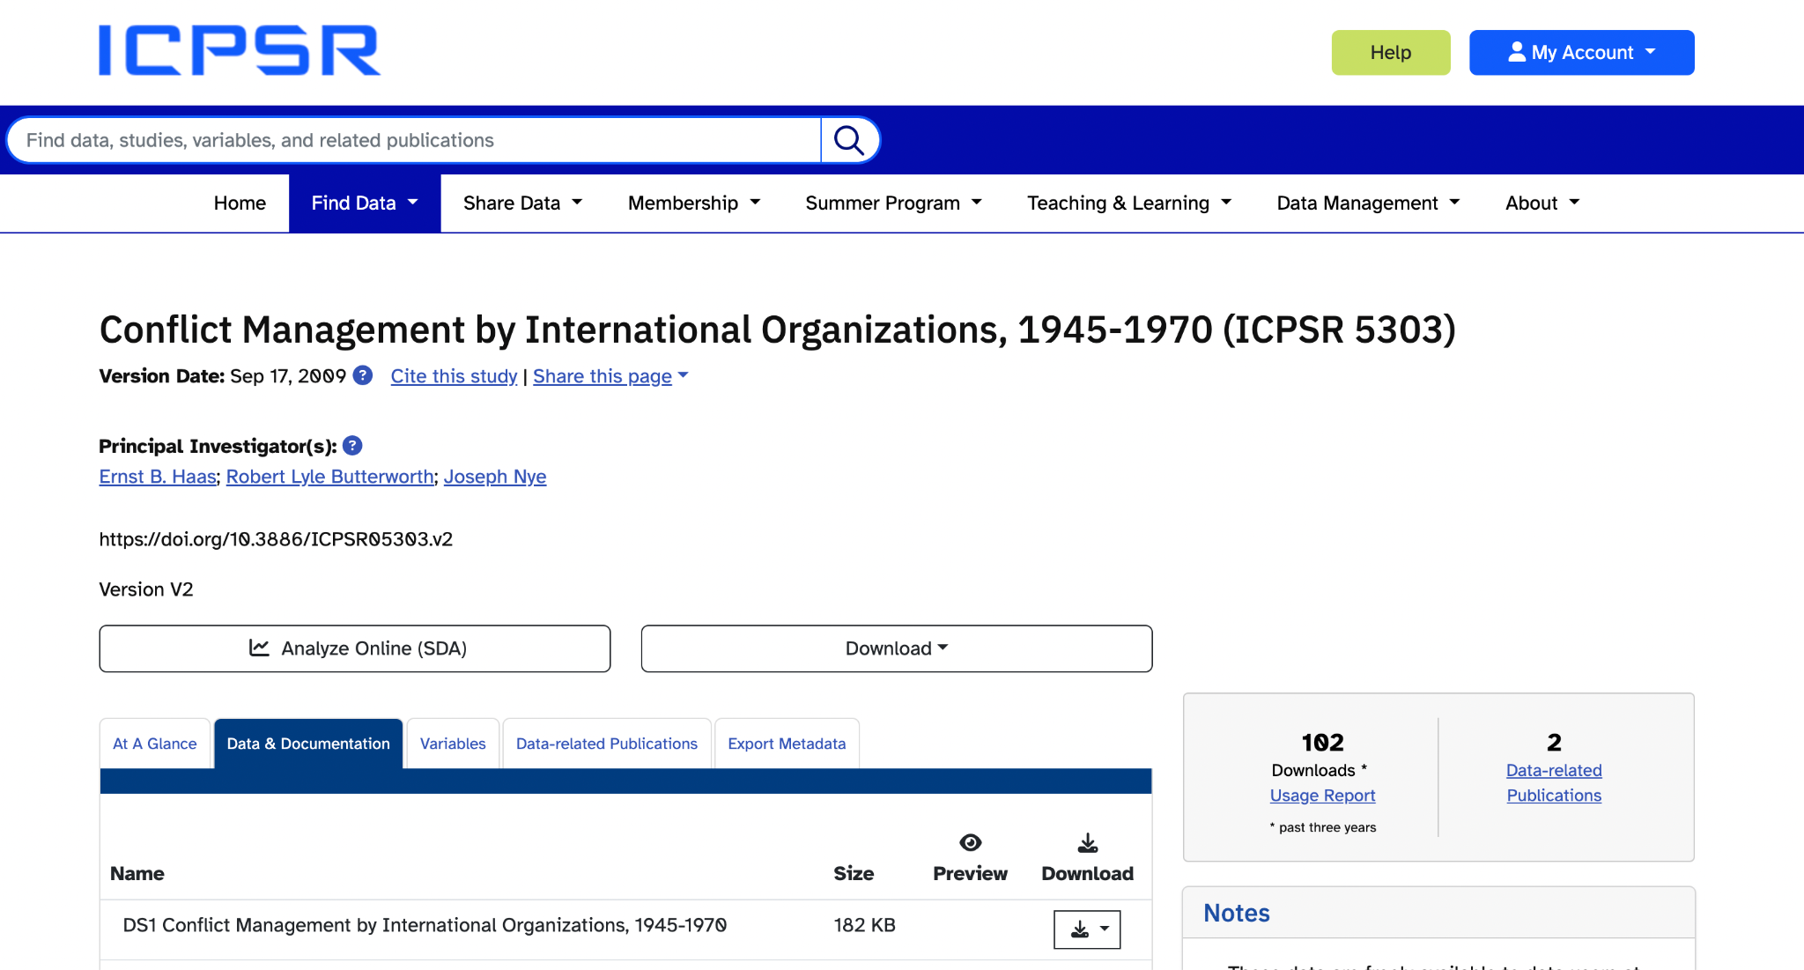
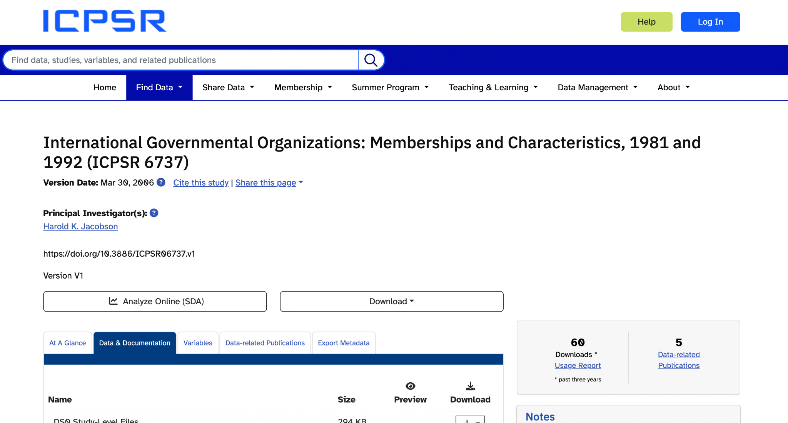
Data we are using

Slide 12
What is this Analysis?
We are looking at how different factors (independent variables) affect the success of mediation efforts by international organizations (the dependent variable). The factors include:
Power asymmetry (power_of_parties): How much power is concentrated in certain parties.
Conflict intensity (intensity_scale): How severe the conflict is.
Likelihood of disappearance (likelihood_disappearance): The chances that the conflict will resolve without external help.
Duration of hostilities (duration_hostilities): How long the conflict lasts.

Slide 13
How we’re calculating it
We are using a Ordinary Least Squares (OLS) Regression, a statistical tool that identifies how one variable (dependent variable) changes in response to others (independent variables).
University of Utah Sociology Department: OLS “is a common technique for estimating coefficients of linear regression equations which describe the relationship between one or more independent quantitative variables and a dependent variable (simple or multiple linear regression), often evaluated using r-squared.”

Slide 14
Accounting for Alternative Explanations
Through adding variables that could influence the dependent variable (raw_success_score) besides the independent variables of interest we can account for alternative explanations.
This helps control isolates the effect of the main independent variable (power_of_parties).
  Examples of Controls:
    Conflict Type: Some conflicts (e.g., ethnic or territorial) may be inherently harder to mediate.
    Resource Availability of IOs: Mediation success may depend on the personnel or funding an organization has.
    Historical Relationships: Long-standing tensions between parties may reduce mediation effectiveness.

Slide 15
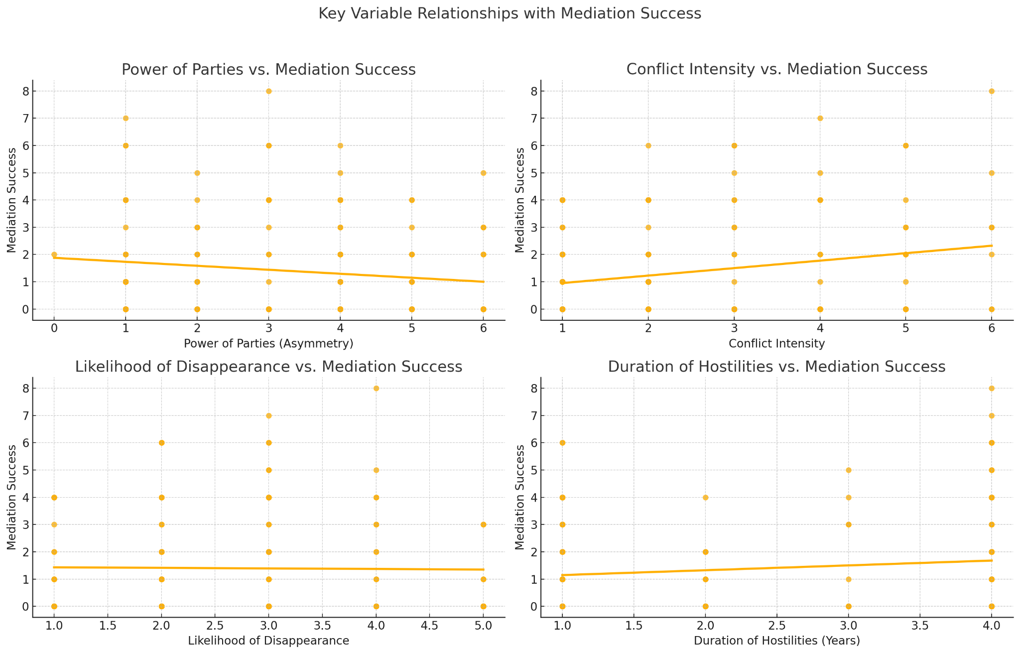
RESULTS
Variable | Effect on Success | Explanation
R-squared | 0.113 | Indicates that the model explains approximately 11.3% of the variance in mediation success.
Power of Parties | Coefficient=-0.172, p=0.051 | This suggests a marginal negative relationship between power asymmetry and mediation success, aligning with the hypothesis.
Intensity Scale | Coefficient=0.4443, p=0.001 | Higher intensity conflicts are positively associated with mediation success.
Likelihood of Disappearance | Coefficient = -0.3428, p=0.024 | Indicates that conflicts unlikely to disappear without intervention negatively affect success.
Duration of Hostilities | Coefficient = 0.0429, p=0.740 | No significant impact on success.

Slide 16
What do these numbers mean in simple terms?
1. Power of Parties (Asymmetry) vs. Mediation Success
The negative slope confirms that higher power asymmetry tends to decrease mediation success. This aligns with the hypothesis, suggesting that unequal power dynamics hinder effective conflict resolution.
2. Conflict Intensity vs. Mediation Success
A positive slope shows that more intense conflicts are associated with higher mediation success. This may reflect the urgency in resolving high-intensity conflicts, leading to greater collaboration among parties.

Slide 17
What do these numbers mean in simple terms?
3. Likelihood of Disappearance vs. Mediation Success
The negative relationship indicates that conflicts less likely to resolve naturally are harder to mediate successfully, highlighting the challenges of intractable disputes.
4. Duration of Hostilities vs. Mediation Success
The flat trendline suggests no significant relationship between how long a conflict lasts and mediation success, indicating other factors might play a larger role.

Slide 18
Conclusion
Key takeaways include:
Power Matters: Unequal power structures in IOs hinder their capacity to mediate conflicts effectively. This points to the need for reforms to balance power among member states.
Intensity is a Double-Edged Sword: While more intense conflicts motivate parties toward resolution, they also pose unique challenges that IOs must navigate with care.
Institutional Design is Crucial: Factors like resource availability, conflict type, and institutional mechanisms can either mitigate or exacerbate the challenges posed by power asymmetry.

Slide 19
Conclusion
How This Advances Understanding
Challenges Conventional Views: This analysis of the effectiveness of IOs questions the assumption that all IOs are equally effective in mediating conflicts, emphasizing the importance of internal power dynamics.
Informs Institutional Reforms: Insights from this research can guide IOs in restructuring their governance and decision-making processes to reduce the influence of dominant states.
Bridges Theory and Practice: By linking quantitative analysis to real-world conflict mediation, the findings provide actionable insights for policymakers and IOs aiming to enhance their effectiveness.

Slide 20
Final Conclusion
This research helps to show that achieving peace in conflict zones requires more than just the presence of an IO; it necessitates well-designed institutional structures. As geopolitical tensions and resource constraints grow, looking at data regarding political activity are vital for improving the global community's ability to manage and resolve conflicts in a fair manner to ensure the amount of human casualties is reduced.

Slide 21
Thank you (Citations)
Boehmer, Charles, Erik Gartzke, and Timothy Nordstrom. 2004. "Do Intergovernmental Organizations Promote Peace?" World Politics 57(1): 1-38.
Wallensteen, Peter, and Isak Svensson. 2014. "Talking Peace: International Mediation in Armed Conflicts." Journal of Peace Research 51(2): 315–327.
Mele, Valentina, Simon Anderfuhren-Biget, and Frédéric Varone. 2015. "Conflicts of Interest in International Organizations: Evidence from Two United Nations Humanitarian Agencies." Public Administration 94(2): 490–508.
Abbott, Kenneth W., and Duncan Snidal. 1998. "Why States Act Through Formal International Organizations." Journal of Conflict Resolution 42(1): 1-32.
Lundgren, Magnus. 2016. "Conflict Management Capabilities of Peace-Brokering International Organizations, 1945–2010: A New Dataset." Conflict Management and Peace Science 33(2): 198–223.
Haas, E. B. (1983). Regime Decay: Conflict Management and International Organizations, 1945-1981. International Organization, 37(2), 189–256.
Chu, Jung-Eun, and Amer Research Taqa. 2015. "The Role of International Organizations in Resolving Global Conflicts." International Journal of Open Publication and Exploration 3(2): 26–32.
Kabore, F. (2023). The Role of International Organizations in Conflict Management in Burkina Faso. Journal of Conflict Management, 3(1), 37–49.
Haas, Ernst B., Butterworth, Robert Lyle, and Nye, Joseph. Conflict Management by International Organizations, 1945-1970. Inter-university Consortium for Political and Social Research [distributor], 2009-09-17. https://doi.org/10.3886/ICPSR05303.v2, https://www.icpsr.umich.edu/web/ICPSR/studies/5303/datadocumentation#
Jacobson, Harold K. International Governmental Organizations: Memberships and Characteristics, 1981 and 1992. [distributor], 2006-03-30. https://doi.org/10.3886/ICPSR06737.v1, https://www.icpsr.umich.edu/web/ICPSR/studies/6737/datadocumentation#
University of Utah, Department of Sociology. "Regression." University of Utah, Department of Sociology, [no date of publication]. https://soc.utah.edu/sociology3112/regression.php#:~:text=Ordinary%20least%20squares%20(OLS)%20regression%3A%20a%20technique%20in%20which,%22best%2Dfitting%20line.%22

